Slide 1
Introduction to Programming

Slide 2
Program
Dictionary Definition: A plan or schedule of activities, procedures, etc. to be followed
Computing Context: A series of instructions that can be put into a computer in order to make it perform an operation.

Slide 3
Programming
Programming is writing computer code to create a program, to solve a problem.
Programs are created to implement algorithms.
Algorithms can be represented as pseudocode or a flowchart, and programming is the translation of these into a computer program.
Pseudocode: a simple way of writing programming code in English
Flowchart: a diagram that depicts a process, system or computer algorithm.

Slide 4
Pseudocode: How to cook rice
START
Wash the rise
Use the right ratio of water
Bring the water to a boil
Add a big pinch of salt
Maintain a simmer
Cook without peeking or stirring
Fluff the rice with a fork
Turn off the stove
Show rice
End

Slide 5
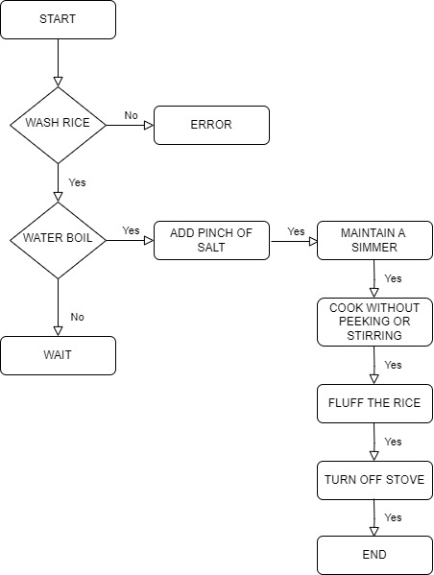
Flowchart: How to cook rice

Slide 6
Programming
Steps in learning English language
Steps in learning C++ language
Alphabets
Words
Sentences
Paragraph
Alphabets
Digits
Special symbols
Constants
Variables
Keywords
Instructions
Program

Slide 7
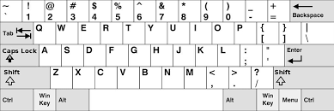
C++ language Character Set
Alphabets
Digits
Special symbols

Slide 8
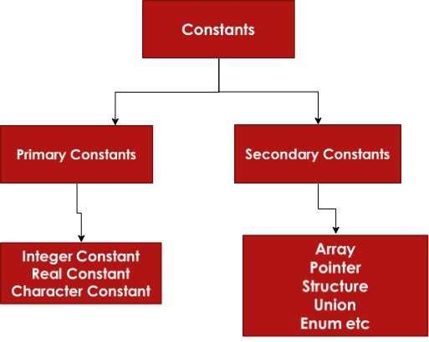
Constant, Variable, Keywords

Slide 9
Constant, Variable, Keywords
C++ Keyword
asm double new switch
auto else operator template
break enum private this
case extern protected throw
catch float public try
char for register typedef
class friend return union
const goto short unsigned
continue if signed virtual
default inline sizeof void
delete int static volatile
do long struct while
include

Slide 10
Role of Compiler and Linker

Slide 11
Compiler
A compiler is a software tool that translates high-level programming language code (like C++ or Java) into machine code that a computer can execute. It performs the following tasks:
Tokenization: Breaks the source code into tokens (basic elements like keywords and operators)
Syntax Checking: Ensures the code’s structure is correct
Semantic Checking: Verifies the logical consistency and meaning of the code
Intermediate Code Generation: Creates a low-level code that is independent of the machine
Optimization: improves the code for better performance
Machine Code Generation: Converts the optimized intermediate code into machine-specific code, resulting in object files

Slide 12
Linker
A linker is a tool that takes the object files generated by the compiler and combines them into a single executable program. Here’s what it does:
Symbol Resolution: Matches function and variable names to their actual memory addresses
Address Assignment: Assigns final memory addresses to the code and data sections
Library Linking: includes additional code from libraries which are collections of pre-compiled functions
Relocation: Adjusts the memory addresses in the code so that everything is correctly positioned in the final executable.
Executable Generation: Procedures the final executable file, which can be run by the computer’s operating system.

Slide 13
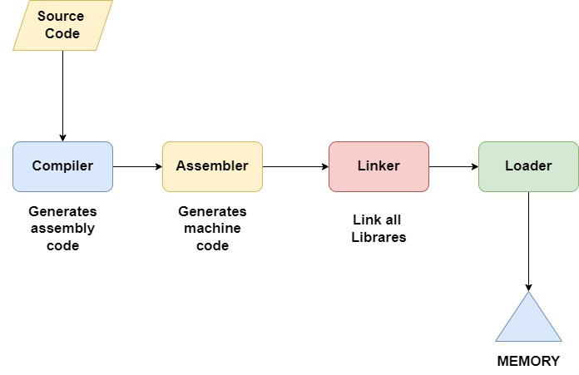
Summary
The compiler translates and optimizes your source code into object files, while the linker combines these object files and additional libraries into a final executable program, ensuring all references are correctly resolved and positioned.

